Slide 1
COMP90054 AI Planning for Autonomy
Workshop Week 3

Slide 2
Objectives of today’s workshop:
Blind Search Algorithm: BFS, DFS, ID, IW

Slide 3
Blind Search Algorithms :
Only use the basic ingredients for general search algorithms.
Depth First Search (DFS)
Breadth-first search (BrFS)
Uniform Cost (Dijkstra)
Iterative Deepening (ID)
Iterated Width (IW)
Heuristic Search Algorithms :
Additionally use heuristic functions which estimate the distance (or remaining cost) to the goal.
A*
WA*
Hill Climbling
Greedy Best First Search

Slide 4
Properties
Optimality
Are the returned solutions guaranteed to be optimal?
Completeness
Is the strategy guaranteed to find a solution when there is one?
Sound
Is the algorithm guaranteed to return correct answers?

Slide 5
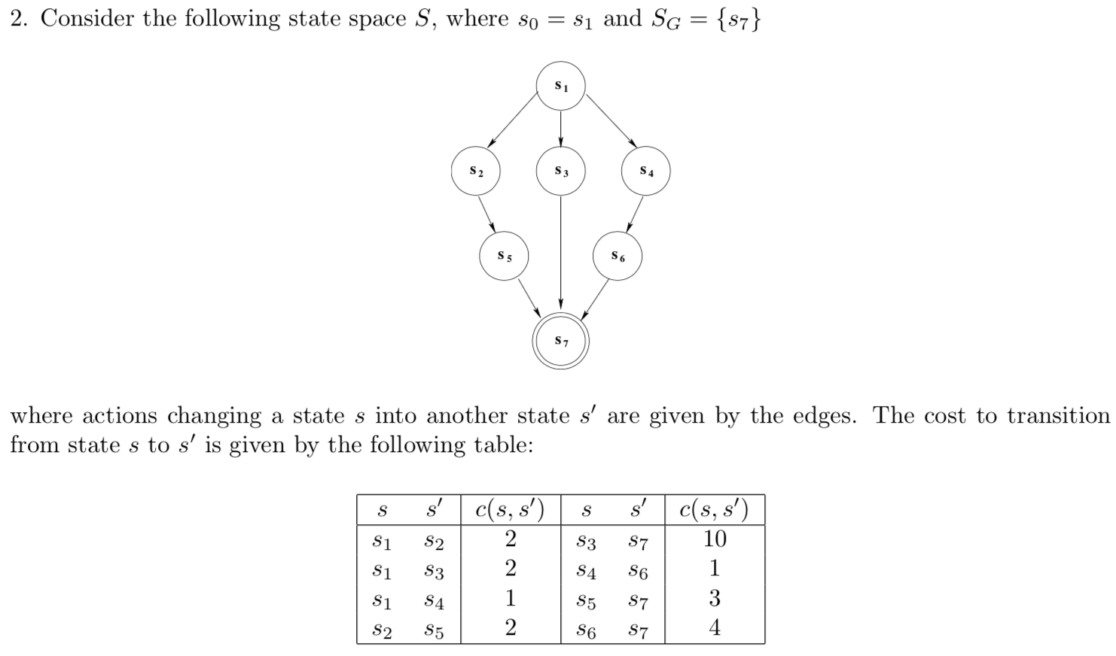
initial state
2
2
1
2
1
10
3
4
goal state

Slide 6
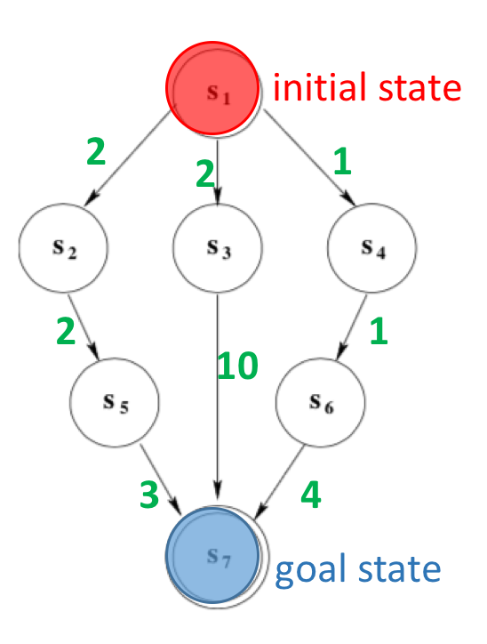
1.BFS
n3 = ⟨ s3, g(n), n_{parent} ⟩
Ordered Sequence of States expanded
n1 = < s1, 0, -- >
n2 = < s2, 2, n1 >
n3 = < s3, 2, n1 >
n4 = < s4, 1, n1 >
n5 = < s5, 4, n2 >
n6 = < s7, 12, n3 >
The solution found by BFS: s1 -> s3 -> s7
The solution is not optimal
BFS will be optimal if the costs are uniform, e.g. all costs are 1

Slide 7
2. DFS
Any one of 3 possible solutions:
s1 -> s2 -> s5 -> s7 cost = 2 + 2 + 3 = 7
s1 -> s3 -> s7 cost = 2 + 10 = 12
s1 -> s4 -> s6 -> s7 cost = 1 + 1 + 4 = 6
DFS can not guarantee optimality

Slide 8
3. Iterative Deepening
depth bound= 0
Depth = 0
Depth = 1
 | 1st stage | 2nd stage
Open
Closed
n1 = < s1, 0, -- >
Depth = 2
n1 = < s1, 0, -- >
Depth = 3
Ordered Sequence of States expanded

Slide 9
3. Iterative Deepening
depth bound= 1
Depth = 0
 | 1st stage | 2nd stage | 3rd stage
Open
Closed
Depth = 1
n1 = < s1, 0, -- >
n2 = < s2, 2, n1 >
n3 = < s3, 2, n1 >
Depth = 2
n4 = < s4, 0, n1 >
n1 = < s1, 0, -- >
n1 = < s1, 0, -- >
Depth = 3
n2 = < s2, 2, n1 >
n3 = < s3, 2, n1 >
n4 = < s4, 0, n1 >
Ordered Sequence of States expanded

Slide 10
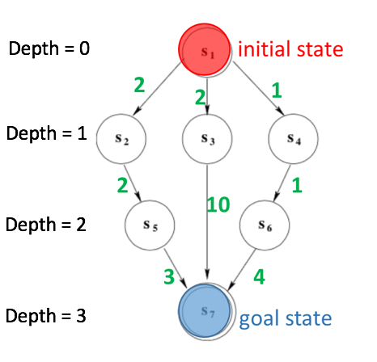
3. Iterative Deepening
depth bound= 2
 | 1st stage | 2nd stage
Open
Closed
n1 = < s1, 0, -- >
n2 = < s2, 2, n1 >
n3 = < s3, 2, n1 >
n4 = < s4, 0, n1 >
n1 = < s1, 0, -- >
 | 3rd stage | 4th stage | 5th stage
Open
Closed
n3 = < s3, 2, n1 >
n3 = < s3, 2, n1 >
n4 = < s4, 0, n1 >
n4 = < s4, 0, n1 >
n4 = < s4, 0, n1 >
n6 = < s7, 0, n3 >
n5 = < s5, 4, n2 >
n1 = < s1, 0, -- >
n1 = < s1, 0, -- >
n1 = < s1, 0, -- >
n2 = < s2, 2, n1 >
n2 = < s2, 2, n1 >
n2 = < s2, 2, n1 >
n5 = < s5, 4, n2 >
n5 = < s5, 4, n2 >
n3 = < s3, 2, n1 >

Slide 11
depth bound= 2
 | 1st stage | 2nd stage
Open
Closed
n1 = < s1, 0, -- >
n2 = < s2, 2, n1 >
The solution found by ID:
s1 -> s3 -> s7
n3 = < s3, 2, n1 >
n4 = < s4, 0, n1 >
n1 = < s1, 0, -- >
3rd stage | 4th stage | 5th stage | 6th stage
n3 = < s3, 2, n1 >
n3 = < s3, 2, n1 >
n4 = < s4, 0, n1 >
n4 = < s4, 0, n1 >
n4 = < s4, 0, n1 >
n4 = < s4, 0, n1 >
n6 = < s7, 0, n3 >
n5 = < s5, 4, n2 >
n1 = < s1, 0, -- >
n1 = < s1, 0, -- >
n1 = < s1, 0, -- >
n1 = < s1, 0, -- >
n2 = < s2, 2, n1 >
n2 = < s2, 2, n1 >
n2 = < s2, 2, n1 >
n2 = < s2, 2, n1 >
n5 = < s5, 4, n2 >
n5 = < s5, 4, n2 >
n5 = < s5, 4, n2 >
n3 = < s3, 2, n1 >
n3 = < s3, 2, n1 >
n6 = < s7, 0, n3 >
Ordered Sequence of States expanded

Slide 12
The solution found by Iterative Deepening:
s1 -> s3 -> s7
The solution is not optimal
ID will be optimal if the costs are uniform, e.g. all costs are 1

Slide 13
 | BFS | DFS | ID
Data structure | Queue | Stack | Stack / repeated DLS
Complete | Yes, if finite (b) | No, in general | Yes, if finite (b)
Optimal | Yes, if equal step costs | No | Yes, if equal step costs
Time | (O(b^d)) | (O(b^D)) | (O(b^d))
Space | (O(b^d)) | (O(bD)) | (O(bd))
Main issue/advantage | Uses lots of memory | Memory efficient | BFS guarantees + DFS memory

Slide 14
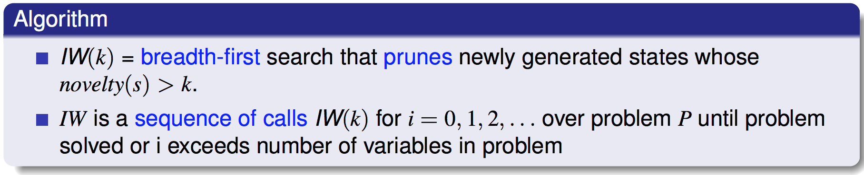
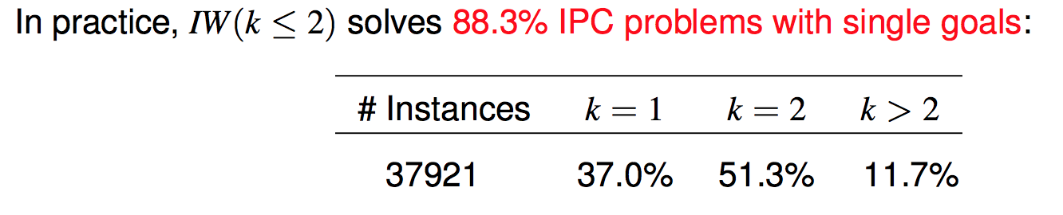
IW (Iterated Width)
Blind Search Algorithm

Slide 15
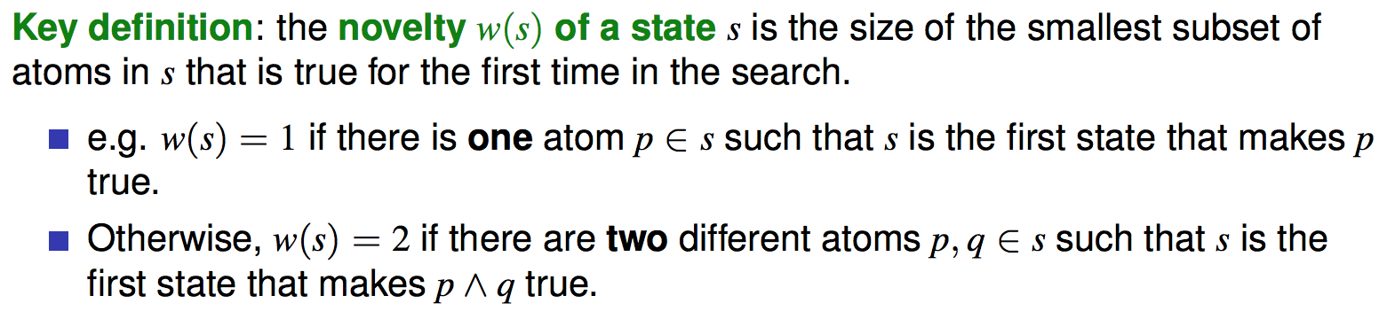
Novelty

Slide 16

How to compute novelty of a state?
A | B | C | D
{A,D}
New things
Novelty
iw(1)
A
1
D
(A,B) | (A,C) | (A,D) | (B,C) | (B,D) | (C,D)
A
iw(2)
D
1
(A,D)
(A,B)
(B,D)

Slide 17
How to compute novelty of a state?
A | B | C | D
{A,B}
New things
Novelty
iw(1)
Empty
|F| = 4
(A,B) | (A,C) | (A,D) | (B,C) | (B,D) | (C,D)
iw(2)
(A,B)
2

Slide 18
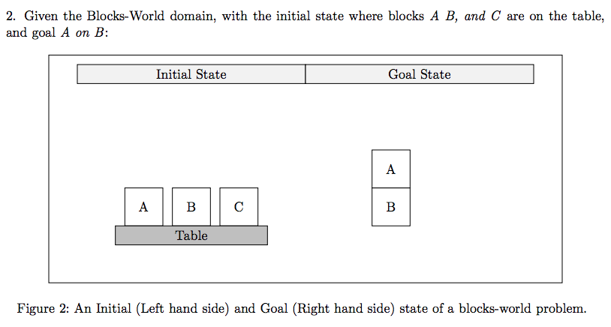

Slide 19
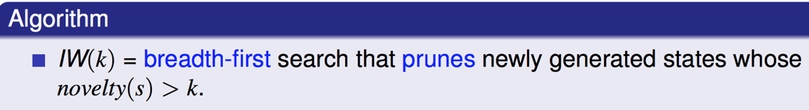

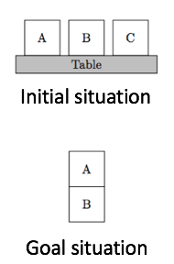
IW(1) process
Initial state: {onTable(A), onTable(B), onTable(C), clear(A), clear(B), clear(C), ArmFree}
Goal state: {on(A,B)}
onT(A) | onT(B) | onT(C) | Cl(A) | Cl(B) | Cl(C) | H(A) | H(B) | H(C) | On(A,B) | On(B,A) | On(A,C) | On(C,A) | On(B,C) | On(C,B) | AF
H(C)
1
Pickup(C)
Initial state
H(B)
Pickup(B)
1
Pickup(A)
H(A)
1

Slide 20
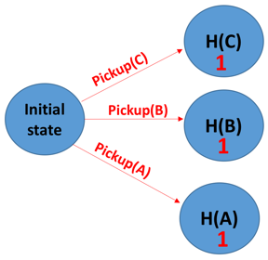
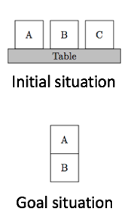
IW(1) process
On(C,A)
1
Stack(C,A)
Stack(C,B)
On(C,B)
1
Putdown(C)
Prune
|F|
> 1

Slide 21
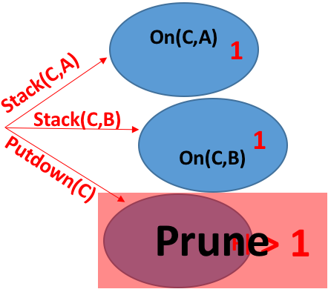
IW(1) process
On(B,A)
1
Stack(B,A)
Stack(B,C)
On(B,C)
1
Putdown(B)
Prune
|F|>1

Slide 22
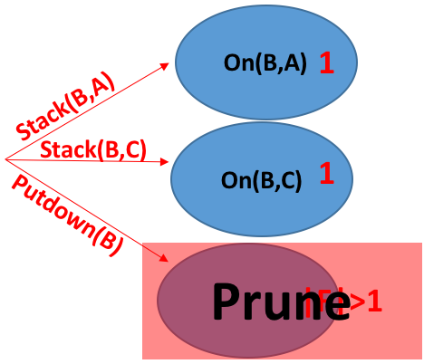
IW(1) process
Achieve Goal
On(A,B)
1
Stack(A,B)
Stack(A,C)
Plan found by IW:
pickup(A), stack(A,B)
Putdown(A)
Optimal

Slide 23
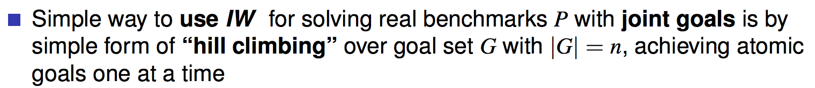
IW (Iterated Width)
If we have single goal, then the plan found by IW is optimal
What if we have more than one goal?
SIW (Serialized Iterated Width)
SIW can not guarantee optimal

Slide 24
A
C
A
B
B
Table
Initial situation
Goal situation

Slide 25
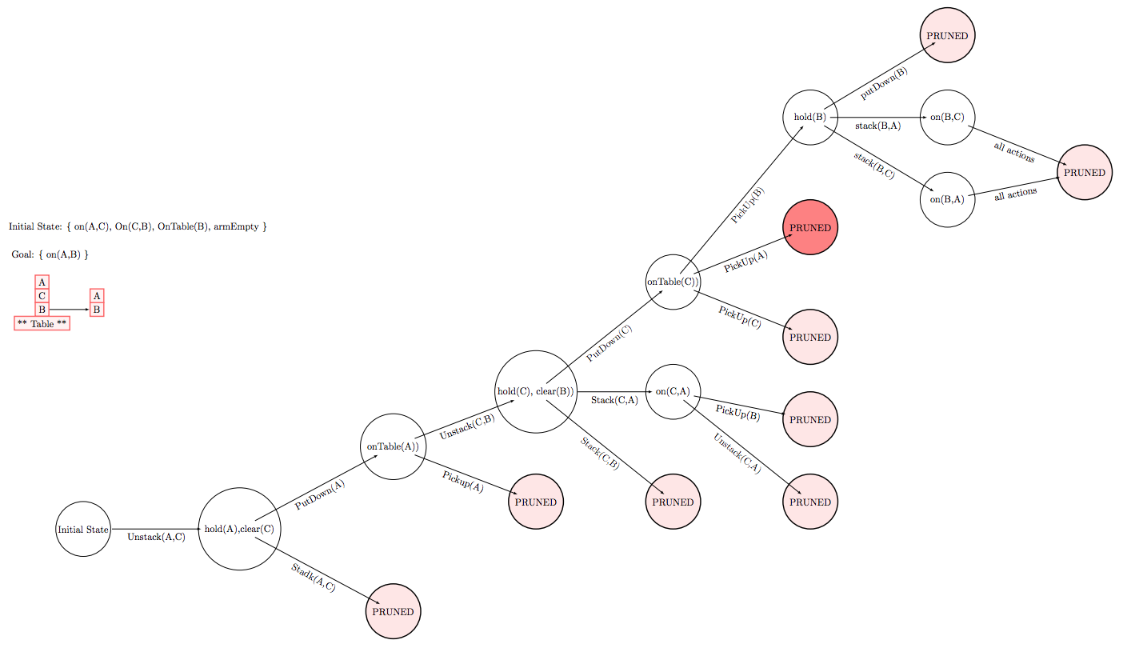
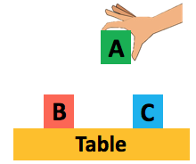
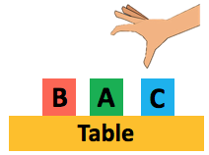
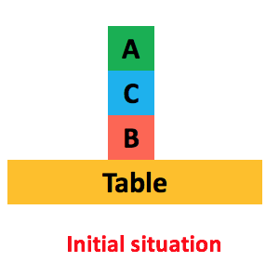
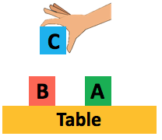
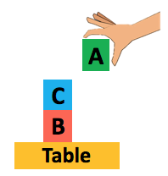
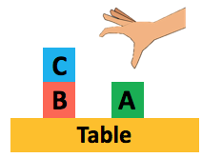
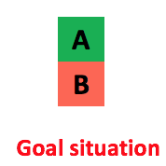
IW(1) process
holding(A)
Then try IW(2), we achieved our goal
holding(A)
Clear(C)

Slide 26
Comparison
IW
BFS
Heuristic Search Algorithms
IW is blind search algorithm, compared with heuristic search, IW doesn’t need additional information about problem
IW is quicker than BFS, because we reduce the number of expansion nodes by pruning with the help of novelty.

